Slide 1

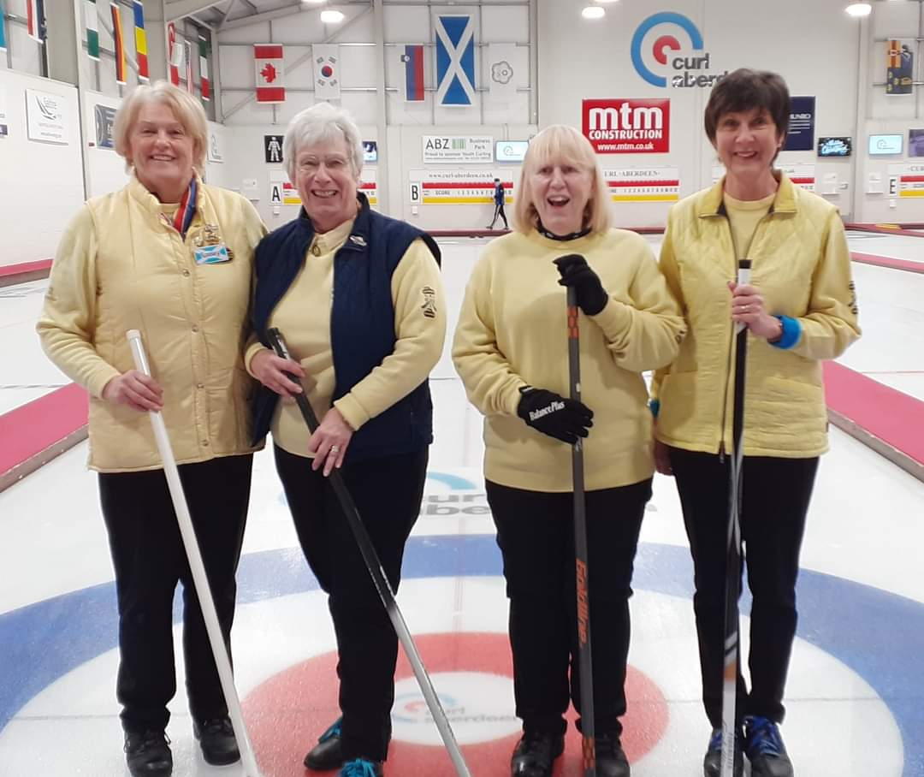
Henderson Bishop Final Teams
Aberdeen
Rosemary Morrison
- Erika Mitchell
- Alison Troup
- Fiona Glascodine

Slide 2
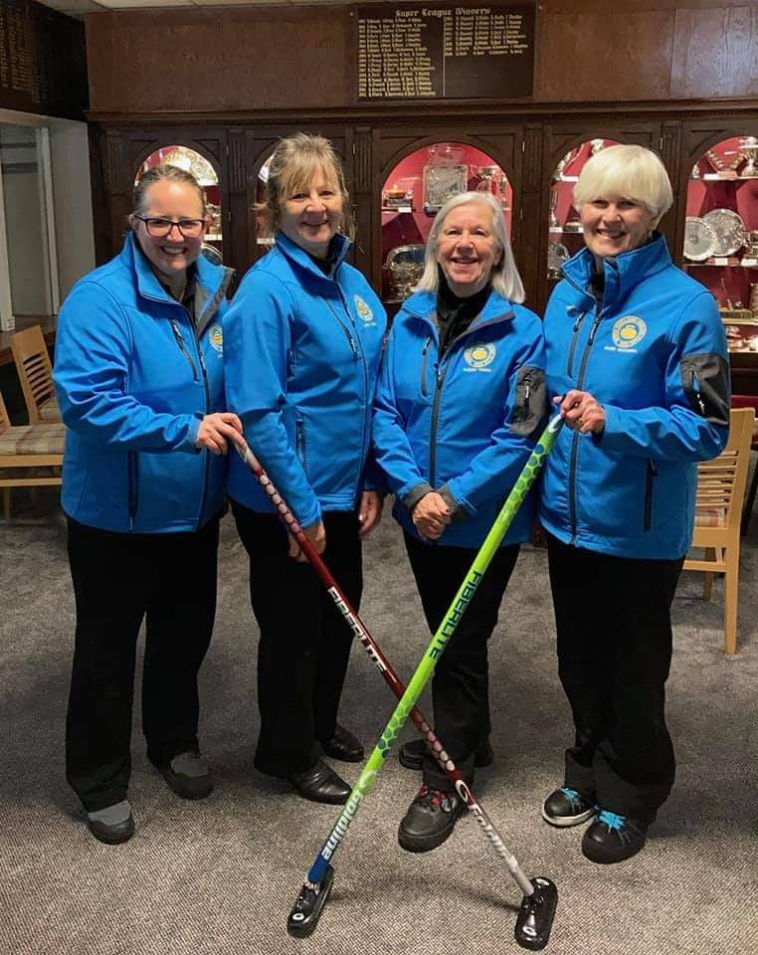
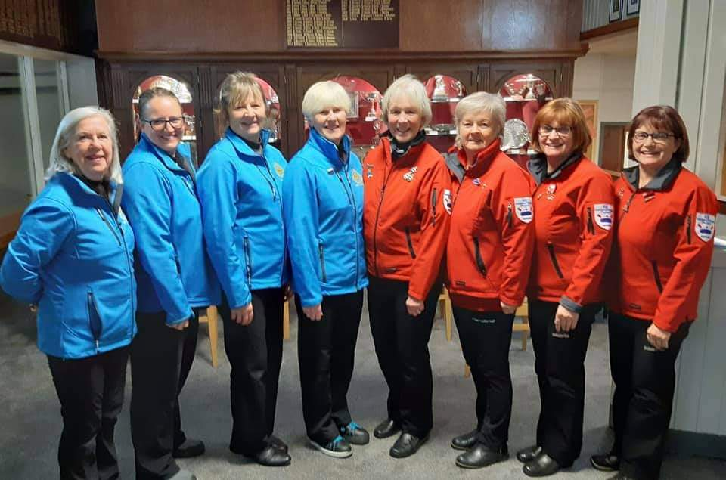
Henderson Bishop Final Teams
Ayr
- Eileen McCorkell
- Mara Lindsay
- Lisa Mason
- Alison Young
Team McCorkell & Team White

Slide 3
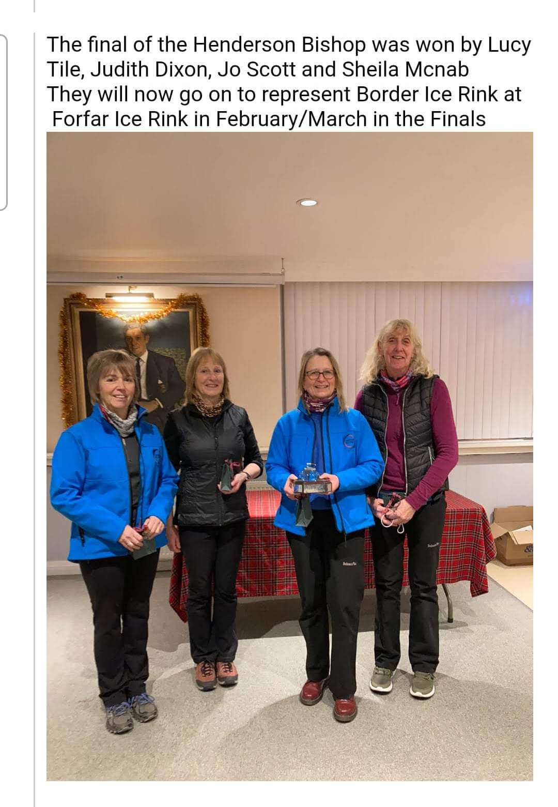
Henderson Bishop Final Teams
Border
Lucy Tile
Judith Dixon
Jo Scott
Sheila McNab

Slide 4
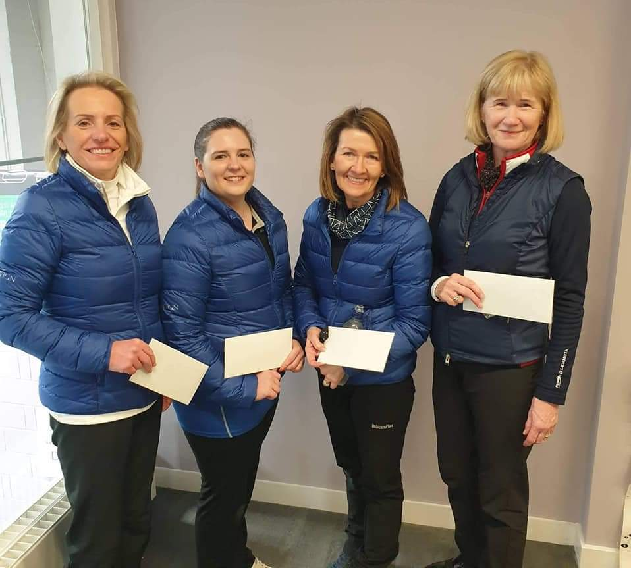
Henderson Bishop Final Teams
Dumfries
Ann Johnstone
Caroline Donaldson
Marion Mather
Fiona Morrison
Susan Morrison

Slide 5
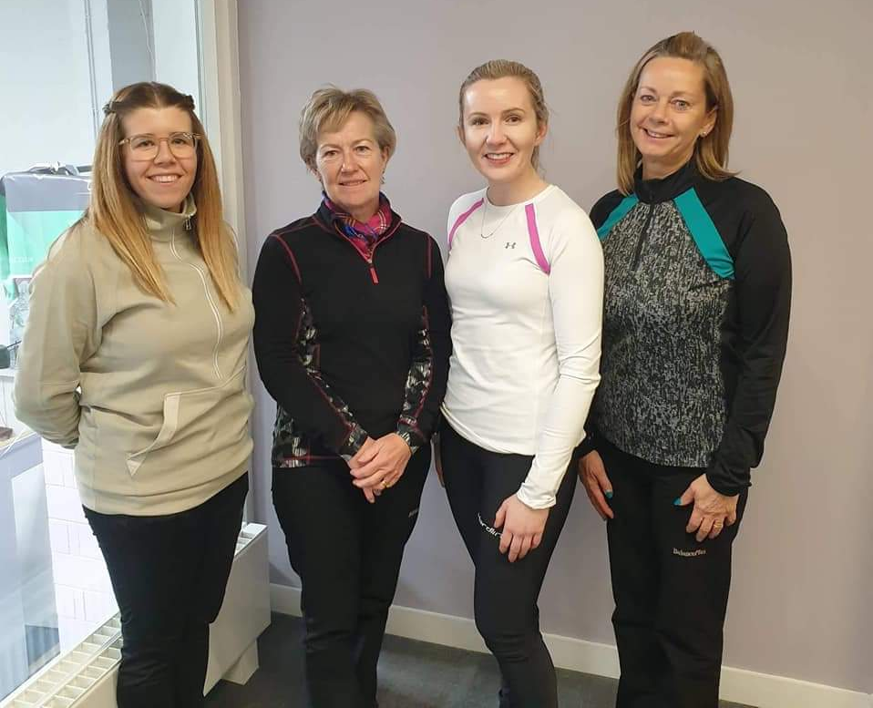
Henderson Bishop Final Teams
Dumfries Runner-Up
Jayne Stirling

Slide 6
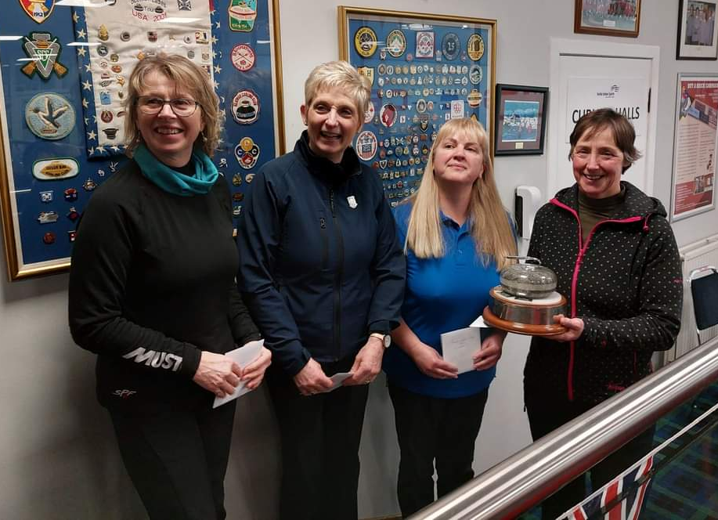
Henderson Bishop Final Teams
Forfar 1
Jill Donald
Liz Furie
Leslie Joiner
Kristina Fairweather

Slide 7
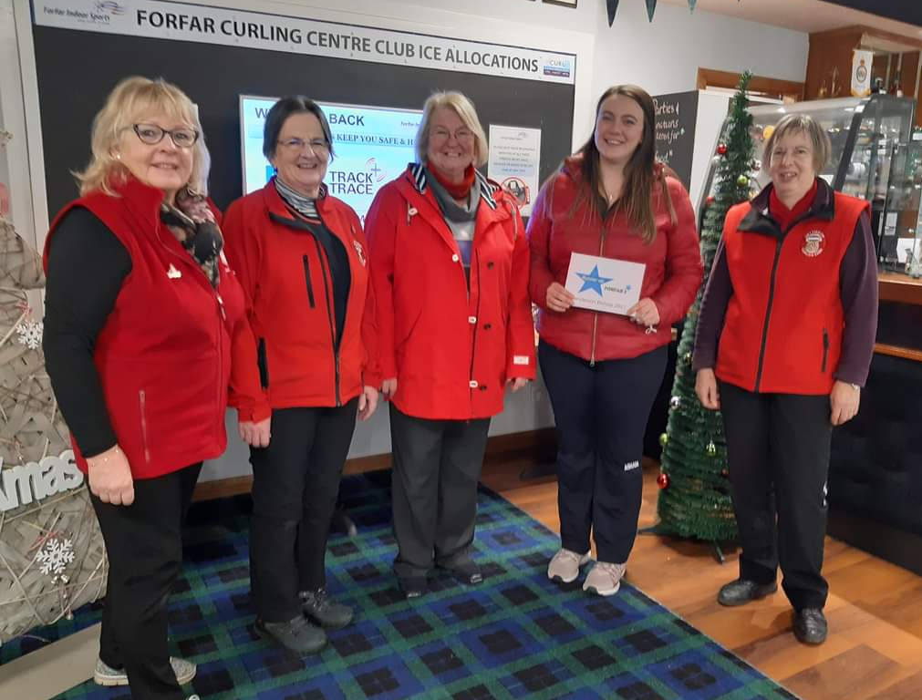
Henderson Bishop Final Teams
Forfar 2
Lesley Young
Ann Kellie
Lorna Anderson
Jenny McGlynn
Marianne Jenkins

Slide 8
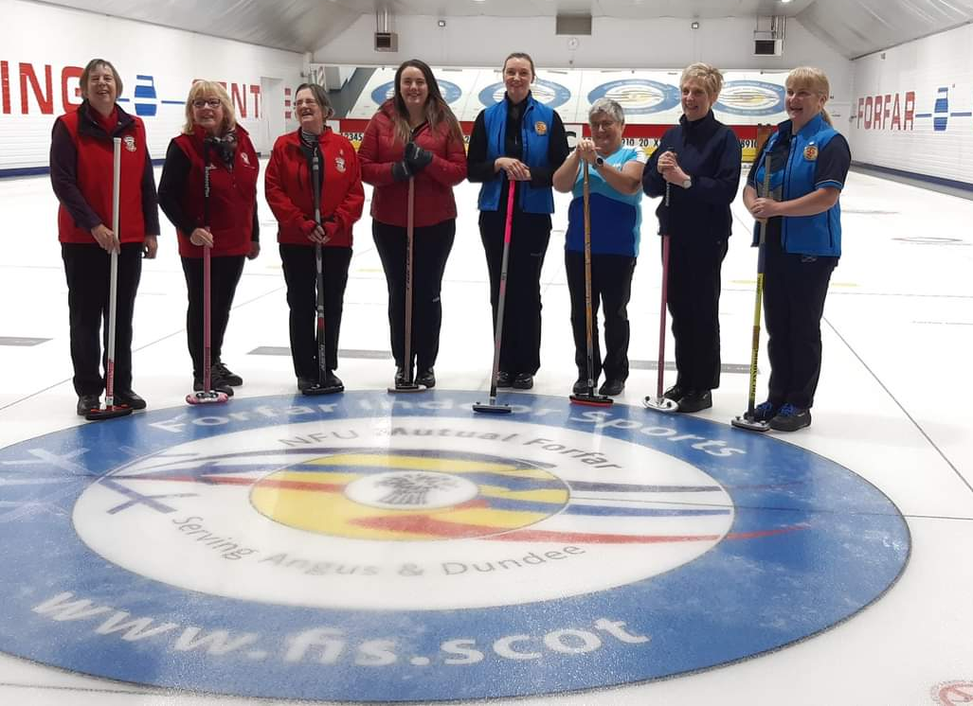
Henderson Bishop Final Teams
Forfar
Team Donald & Team Young

Slide 9
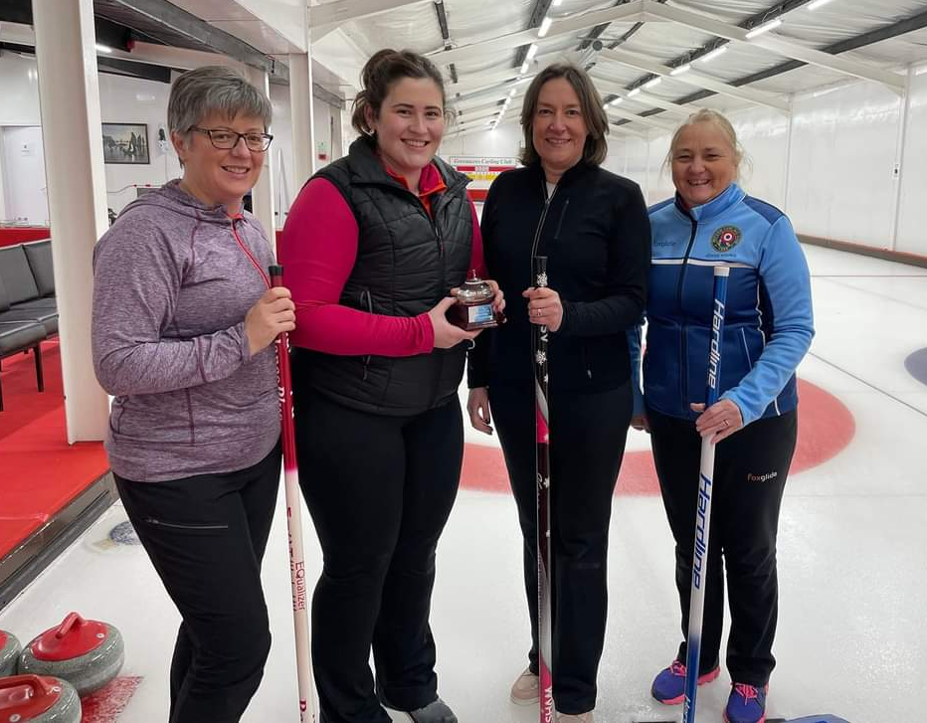
Henderson Bishop Final Teams
Greenacres/ Braehead
Karen Kennedy
Jacqui Taylor
Michelle McIntyre
Joyce Young

Slide 10
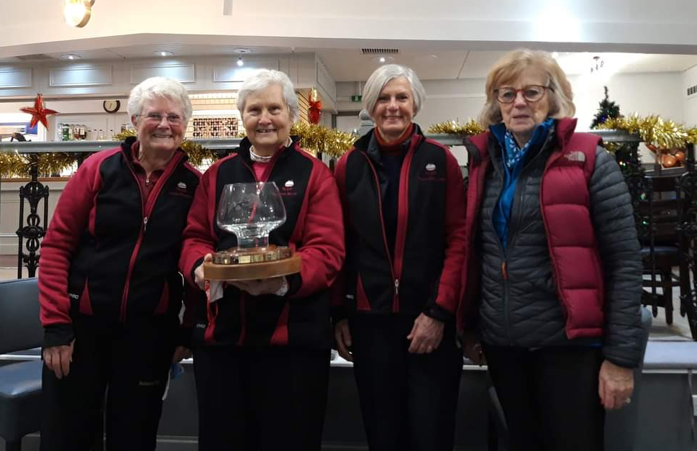
Henderson Bishop Final Teams
Inverness
Yvonne Birnie
Linda Hoskins
Fiona McLaren
Elaine Semple

Slide 11
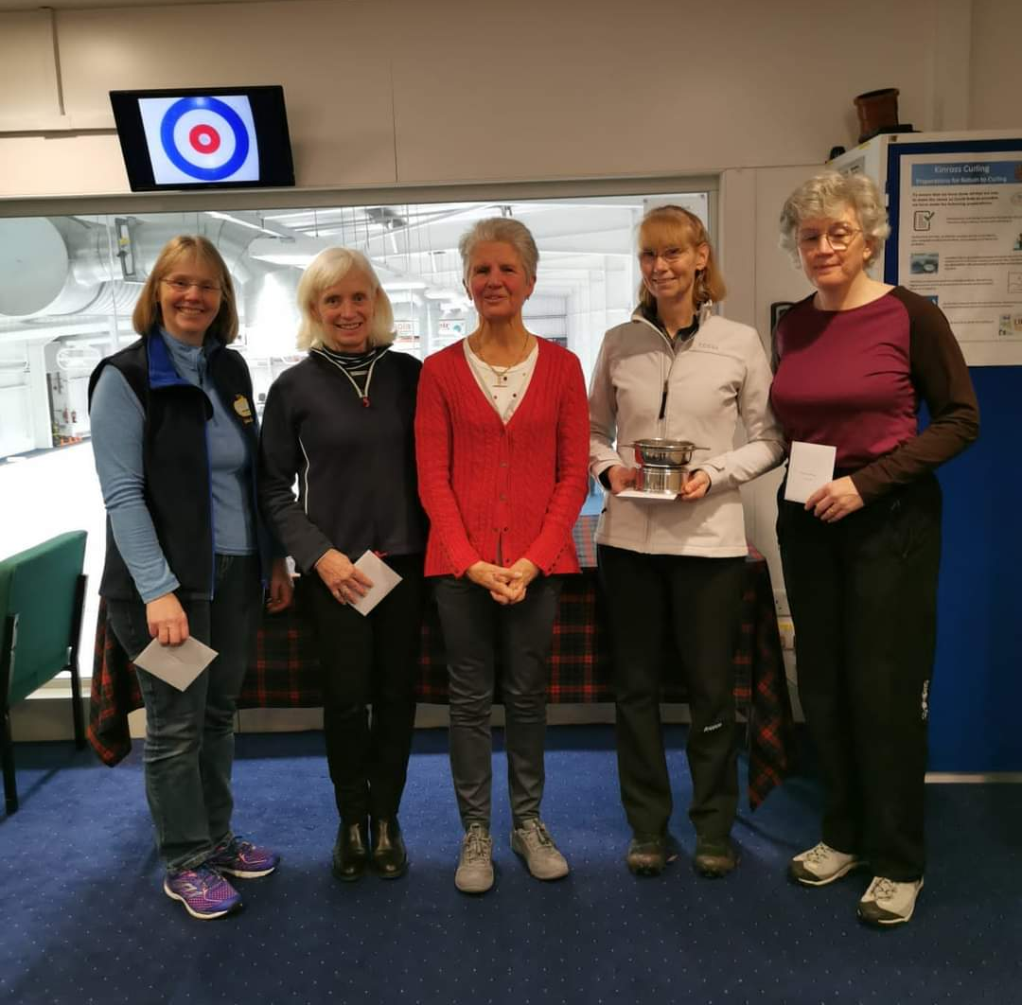
Henderson Bishop Final Teams
Kinross 1
Angela Wilcox
Eileen Thomas
Caroline Liddle
Julie Cormack

Slide 12
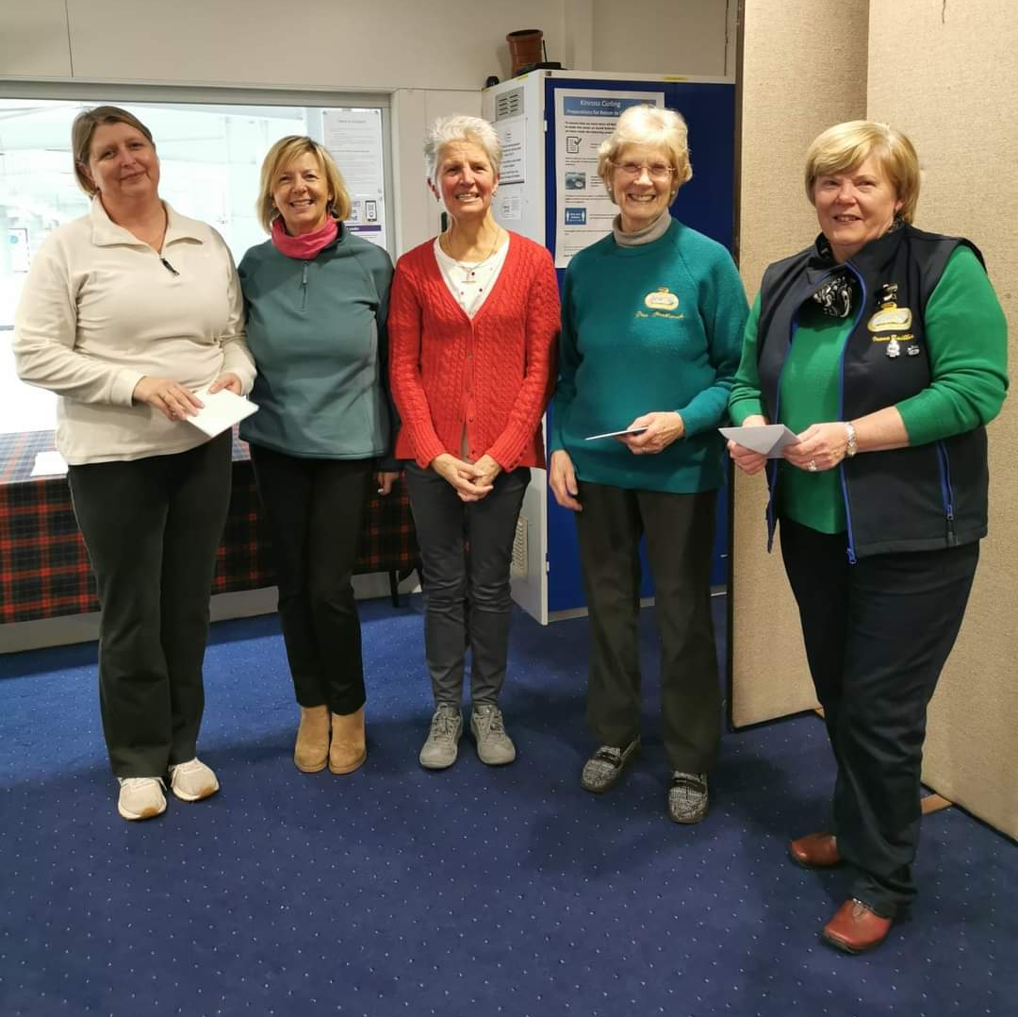
Henderson Bishop Final Teams
Kinross 2
Irene Baillie
Dor Borthwick
Yvonne Wardrope
Lynne Stevenson

Slide 13
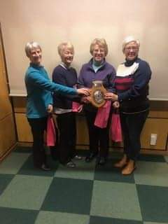
Henderson Bishop Final Teams
Lockerbie
Marion Murdoch
Marilyn Muir
Pam Maxton
Ashley Stoddart

Slide 14
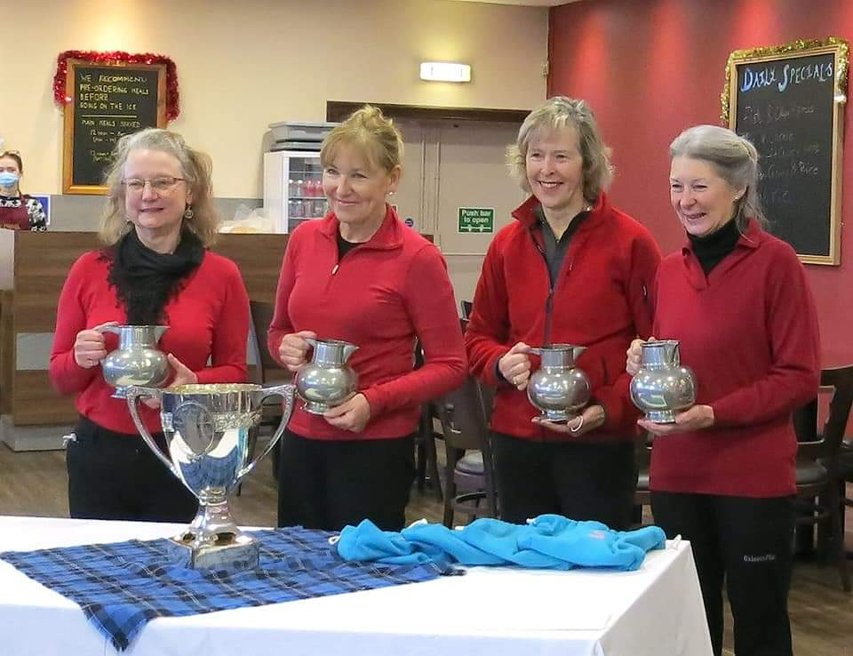
Henderson Bishop Final Teams
Murrayfield 1
Ruth Addinall
Jill Florence
Catherine Dodds
Avril Anderson
Jane Bruce

Slide 15
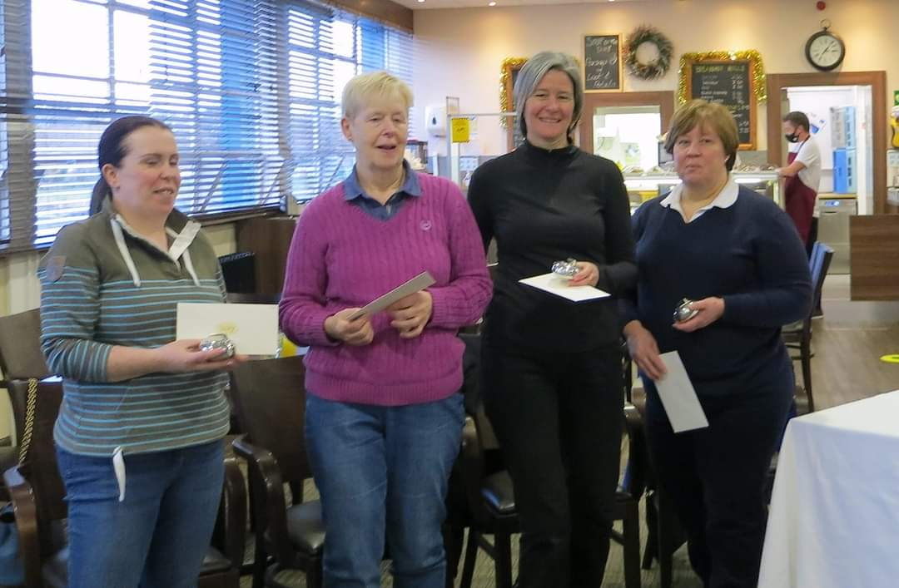
Henderson Bishop Final Teams
Murrayfield 2
Elizabeth Sharp
Judith White
Caroline Fleming
Jeni Fleming

Slide 16
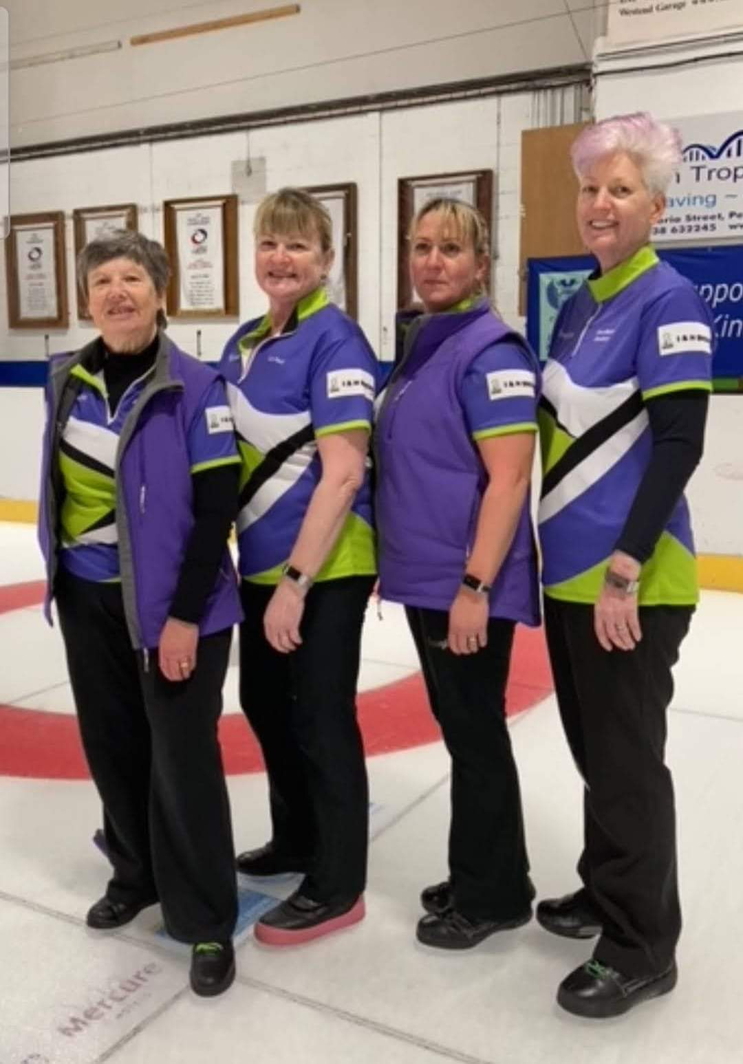
Henderson Bishop Final Teams
Perth
Ann-Maree Davidson
Joanne Flethcher
Liz Paul
Anne Hewitt

Slide 17
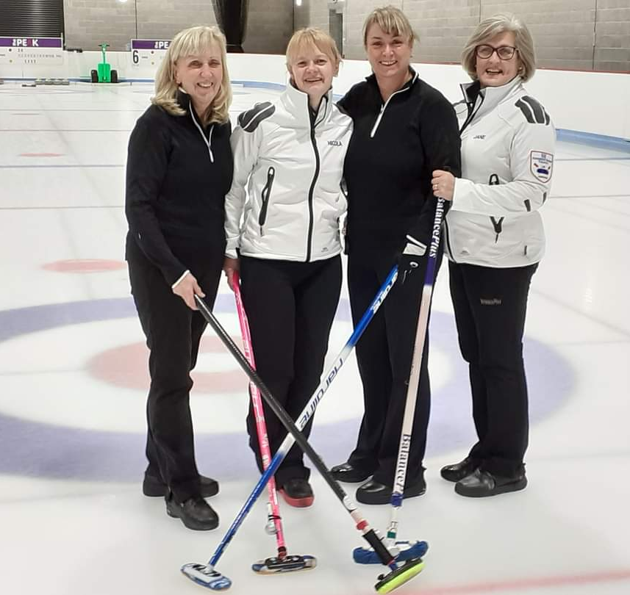
Henderson Bishop Final Teams
Stirling
Jane McLaren
Marjorie Christie
Nicola Woodward
Elspeth Johnston

Slide 18
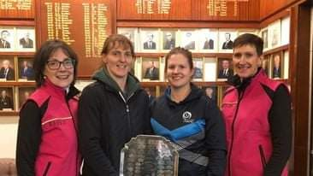
Henderson Bishop Final Teams
Stranraer
Kate Adams
Vicky Chalmers
Kate Wright
Louise Kerr
Jenni Cannon

Slide 19
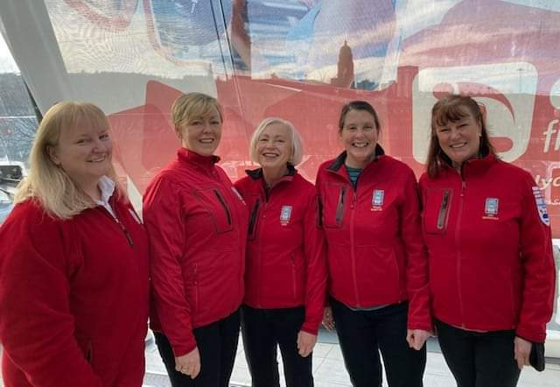
Henderson Bishop Final Teams
Waterfront
Wilma McIntyre
Jackie Orr
Eileen Virtue
Val Marshal
Rhona Cowie

